Slide 1

Movie Ticket Booking App
Gontla Lakshmisrinivasa Yaswanth
Mohith Bolla
Pallapothu Deekshitha
Swetha Moorthy Krishnan

Slide 2
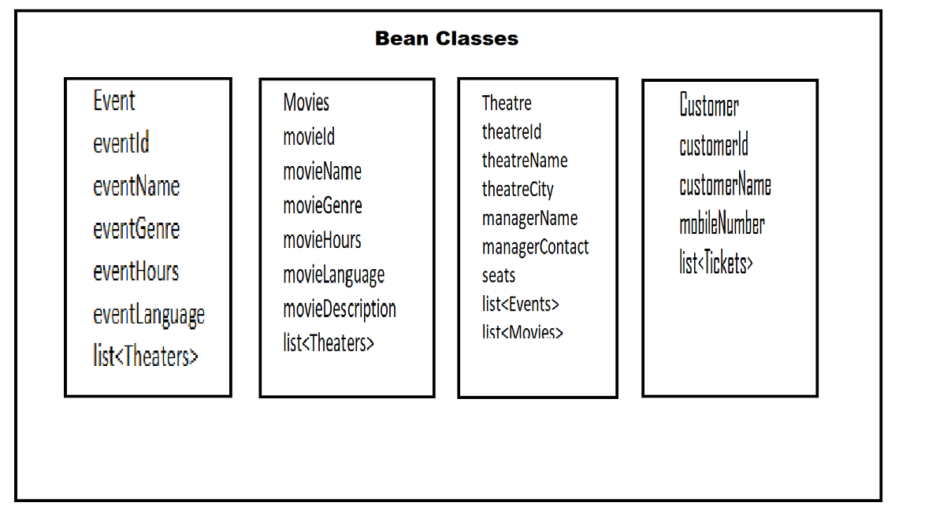
Beans Class

Slide 3
Works Assigned
Deekshitha – Events
Yaswanth – Movies
Mohith – Customers
Swetha - Theaters ,Seats

Slide 4
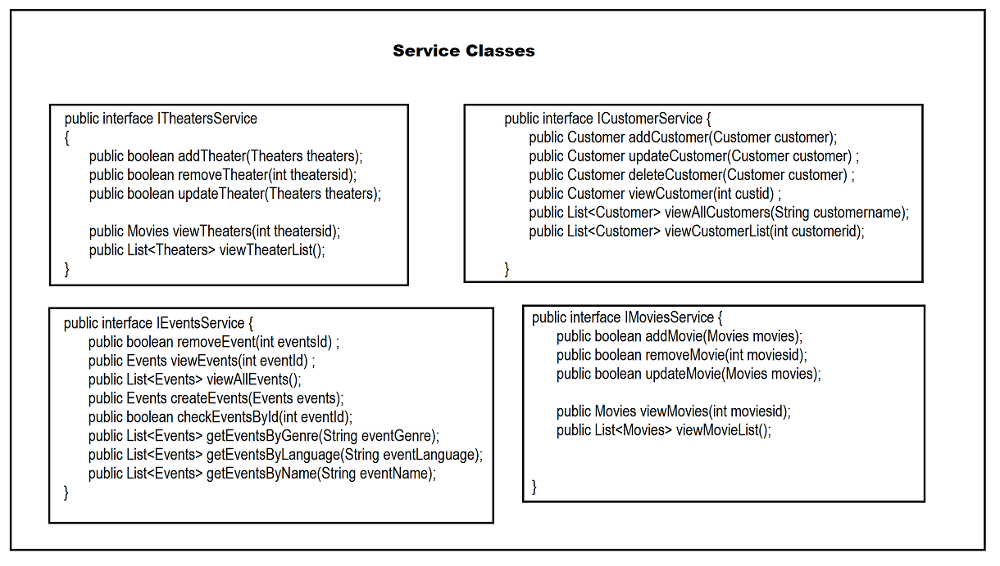
Service Classes

